Slide 1
Best Practices in Cyber Security Maggy Powell Senior Manager Real-Time Systems Security Exelon 21 March 2018

Slide 2
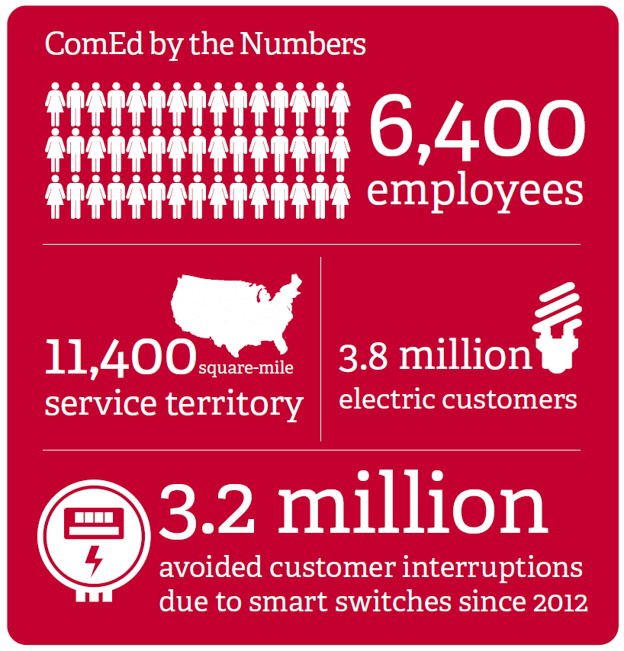
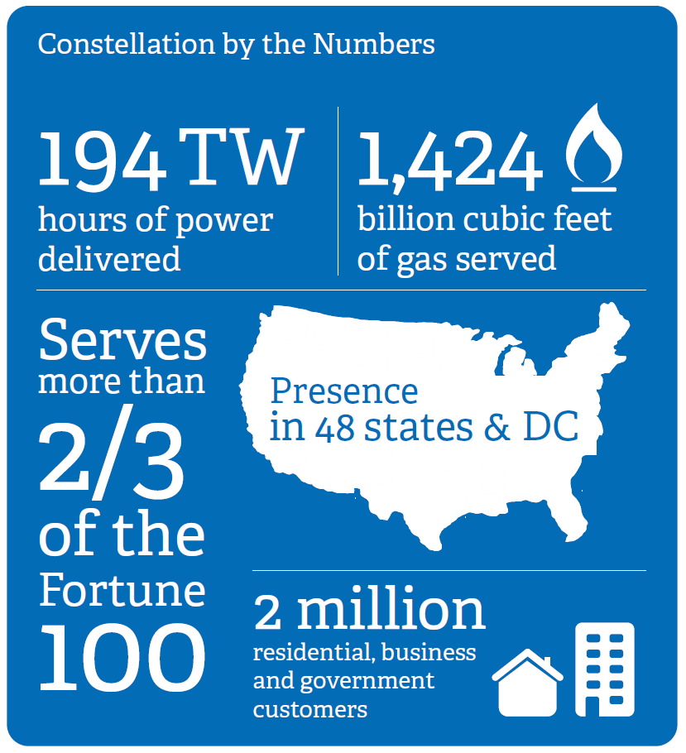
Exelon by the Numbers

Slide 3
Exelon - Real Time Systems Security Team
Real Time Systems Security Engineering
Real Time Systems Security & Compliance
RTSS
MISSION
Industrial Control Systems Security Operations Center

Slide 4
Threats – ICS perspective
Actors
Nation States
Insider Threat
Our own good intentions
Vectors/Vulnerabilities
Supply Chain
Direct Connection to the ICS
Competing Priorities and Limited Resources

Slide 5
Common themes that create emerging threats
Threats
Slow(er) upgrades to existing deployed technologies
Increase in published vulnerabilities and exploit toolkits
Faster adoption of new technology into production environments
Limited understanding of threat implications and mitigations

Slide 6
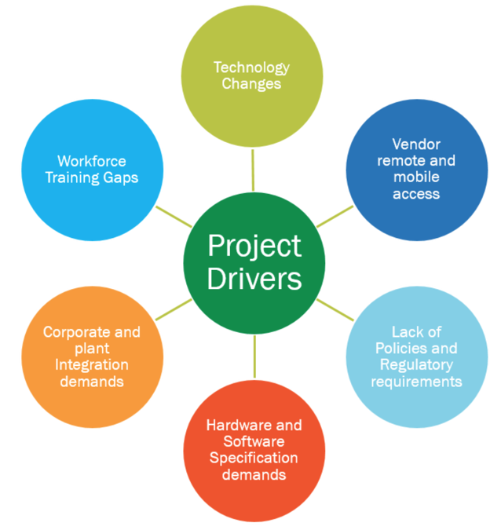
Impact to the Cyber Security Landscape
Convergence of IT/OT
Increasing Complexity
Contributing drivers that either reduce or introduce threats

Slide 7
Innovative Practices – Defense and Response
Trust, but Test
Incident Response capabilities
Доверяй, но проверяй

Slide 8
Trust, but TEST… Security Testing Facility
Network Intrusion Detection
Malicious Code Detection
Forensics
Security Event Monitoring
Access Control
Change Management
Patch Management
Penetration Testing
Vulnerability Assessments

Slide 9
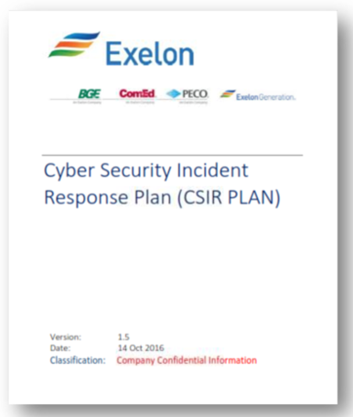
Incident Response Capability
Before | After
Broad network monitoring | Specialized network monitoring
Multiple incident response plans | 1 cyber security incident response plan
Siloed functions dividing physical & cyber | Integrated physical & cyber responses
Siloed response between IT & OT | Integrated IT & OT incident response
Corporate policy disconnected from practical procedures | Corporate policies connected to department and hands-on
IT responders | Inclusion of OT responders

Slide 10
Questions?

